Slide 1


ADVANCED DATA MINING AND PREDICTIVE ANALYSIS
GROUP 5:
Nikitha Chigurupati
Rajeev Varma
Nithin Varma

Slide 2

PROJECT GOAL:
The objective of this project was to develop a predictive model for a bank to predict if a loan will default and the amount of loss that will be incurred if it does default.

Slide 3
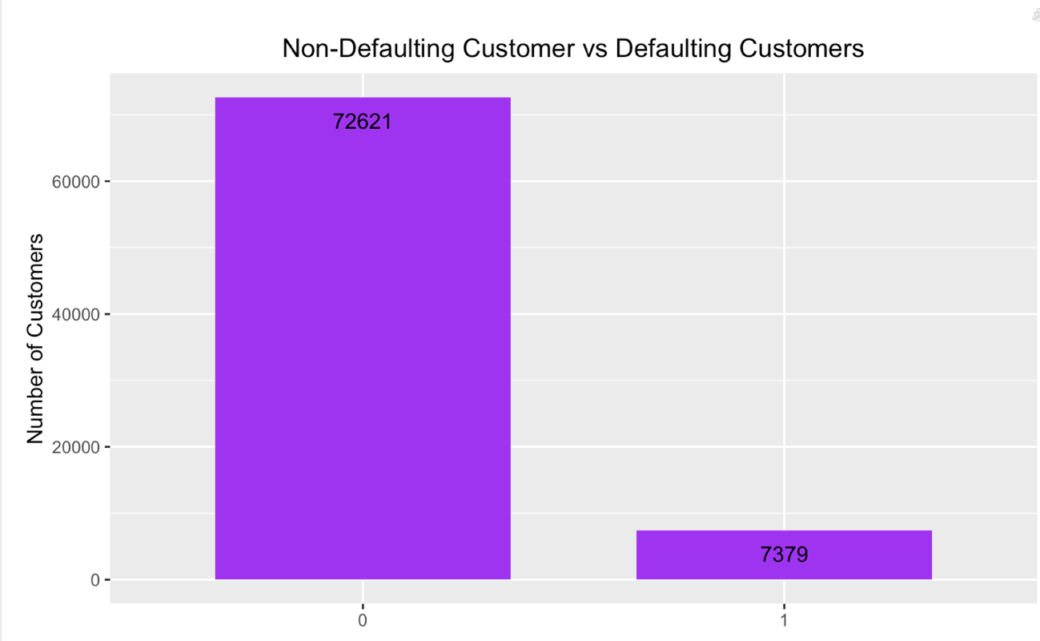
OVERVIEW/STRUCTURE OF THE DATA:
The data set used for the project contains information of the customers of a bank so this dataset has a total of 80,000 records and 763 variables which are all numeric values.
A comparison of defaulting against non-defaulting consumers showed that 72,621 customers paid off their debts in full, whereas 7,379 customers defaulted at some point.

Slide 4
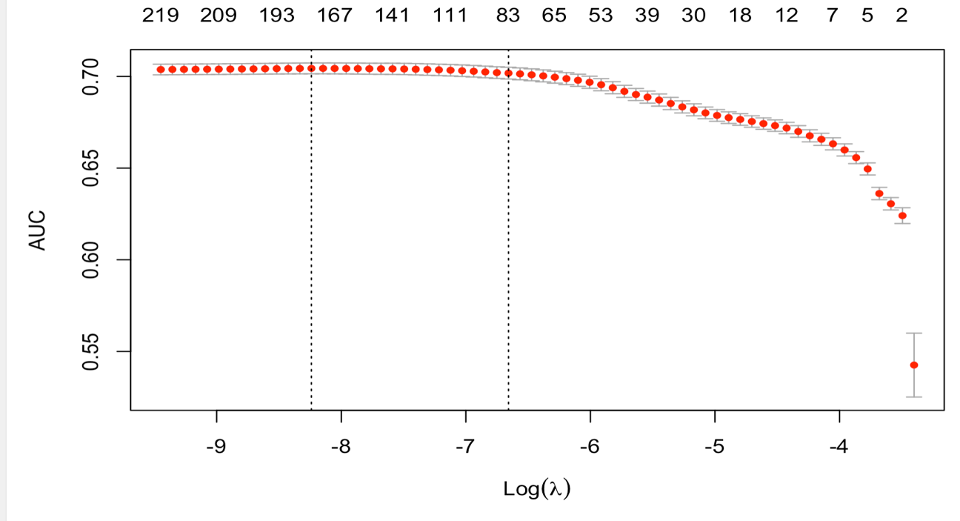

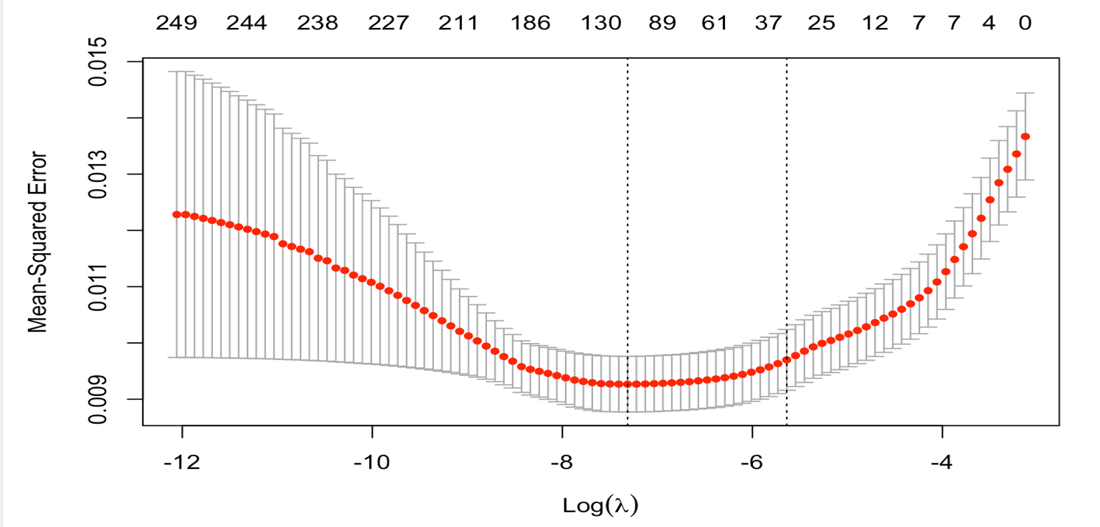
MODELLING STRATEGY:
The idea was to divide the models into two distinct models for this Project:
Forecasting Probability of Default (PD) -
We used a Lasso Regression analysis to accomplish feature selection, Regularization and PCA (Principal Component Analysis) to reduce the number of attributes.
We also built a Random forest Model to find out the Probability of default for a customer in a bank.
Forecast projected Loss Given Default (LGD )-
We used the Ridge Regression to build this model to acquire predictions once the data has been reduced to a smaller size. This Predicts the Loss Given Default and our goal is to reduce the Mean Absolute Error (MAE)

Slide 5
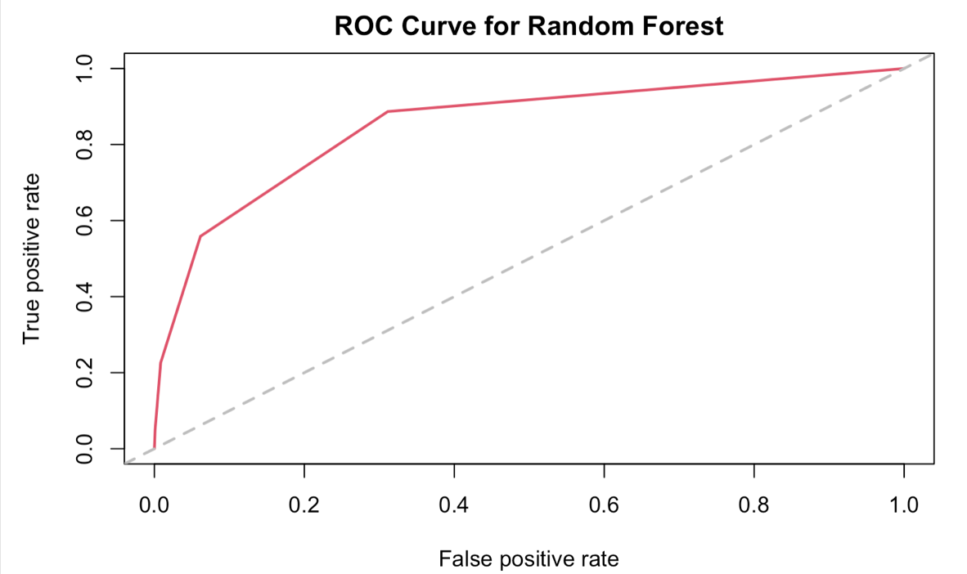
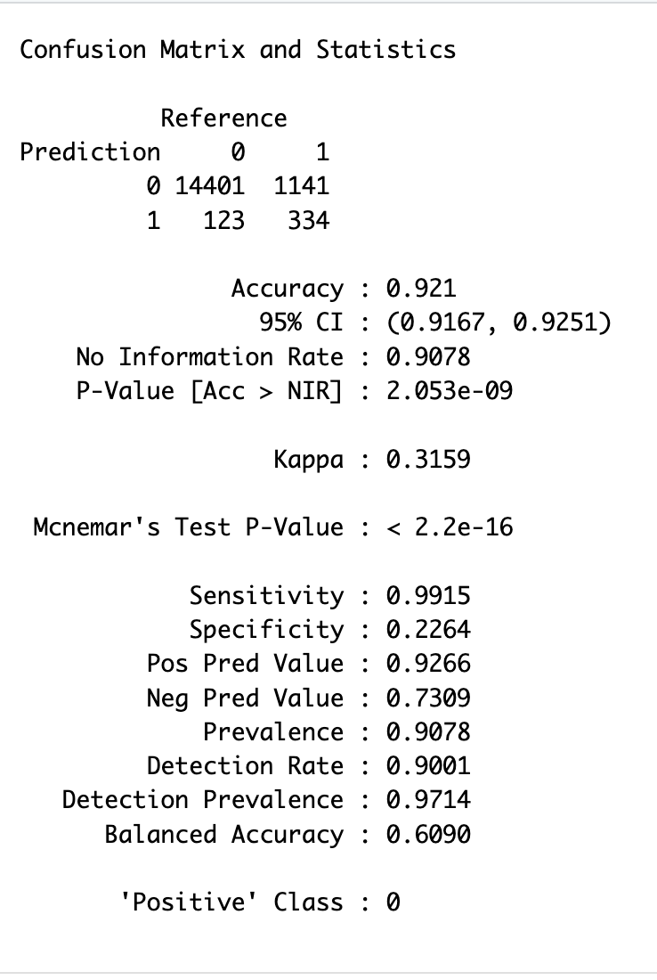
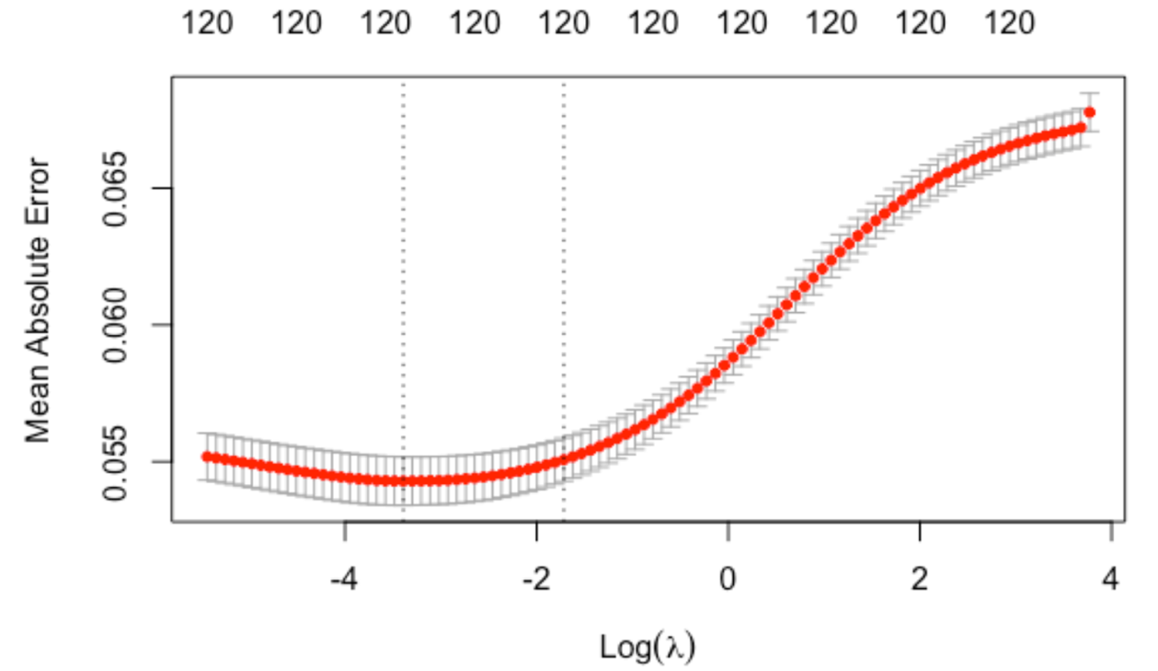
ESTIMATING MODEL’S PERFORMANCE:

Slide 6
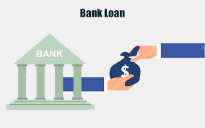
CONCLUSION:
The Lasso model was able to accurately predict the default risk of each customer in the given data set, with an accuracy of 0.921 or 92.1%.
The ROC curve and the AUC were used to evaluate the model's performance, with the PD model obtaining an excellent predictive performance with an AUC of 0.85
Customers paid 75% of their debt before defaulting, with only a few defaulting on the entire amount.

